Slide 1
Cultural Exchange Program
Chung-Shing Primary School (CSES)

Slide 2
This Cultural Exchange Program for English-Speaking Countries consists of the overview of the CSES demographics, school features, MOU prospective,and our contact window.
Your consideration will be highly appreciated.
No.10-1, Shizhuo, Zhuqi Township, Chiayi County 604, Taiwan

Slide 3
Things you need to know about CSES

Slide 4
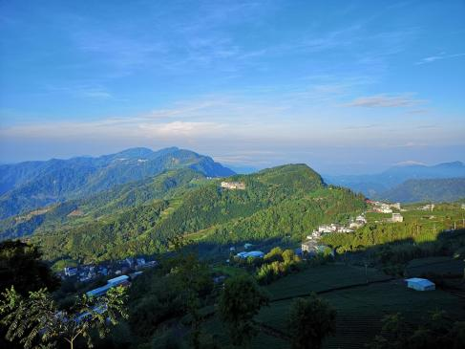
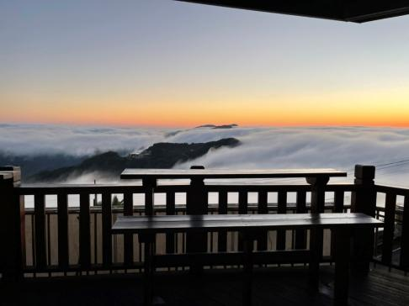
ChiaYi County
Chiayi City in Taiwan is the only city with three national scenic areas Mountain, Ocean, and Plain.

Slide 5
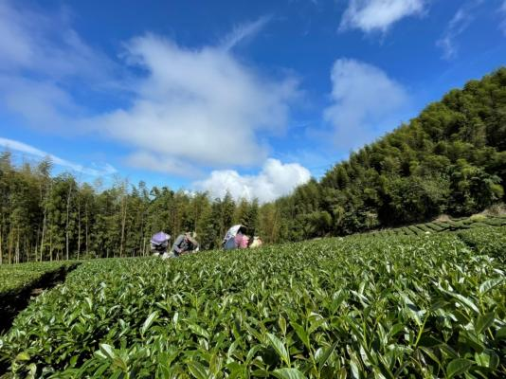
Zhuqi Township
The school is located in Zhonghe Village, Zhuzi Township, surrounded by tea farms and hiking trails. The scenery changes with each season with cherry blossoms and gleaming grass, making it an exceptionally beautiful place.

Slide 6
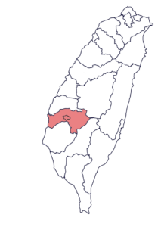
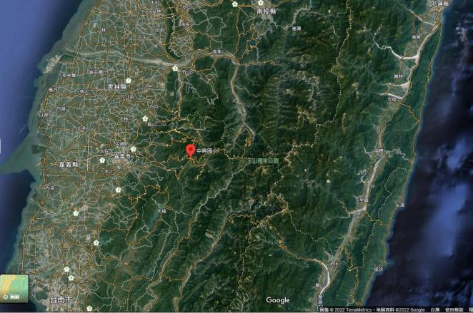
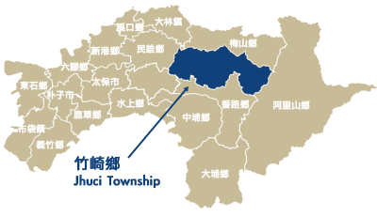
School Location

Slide 7
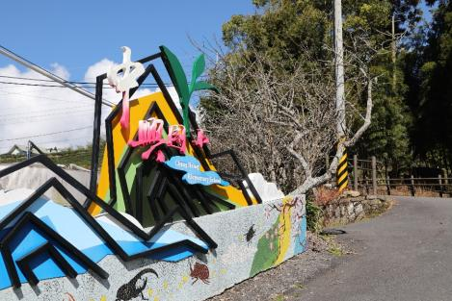
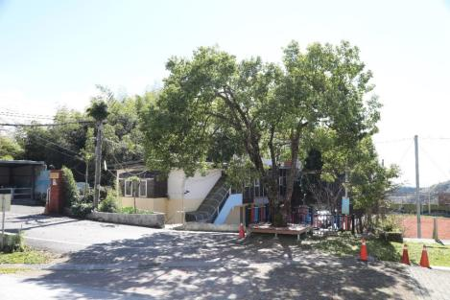
School Gate
Entrance

Slide 8
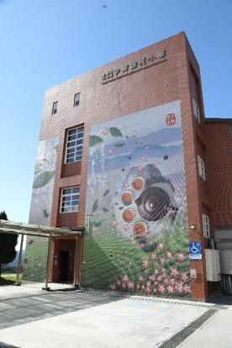
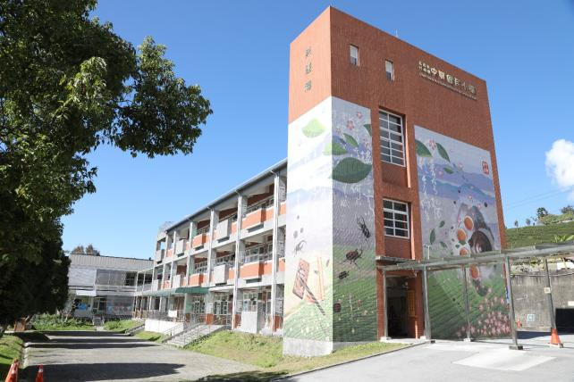
school building

Slide 9
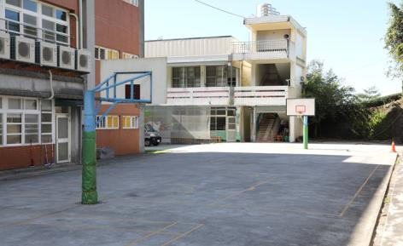
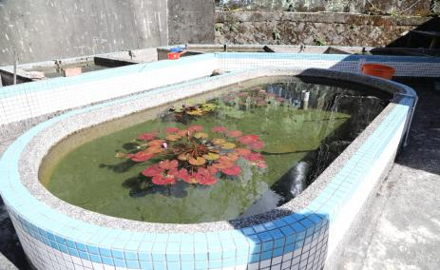
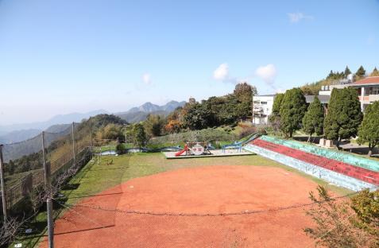
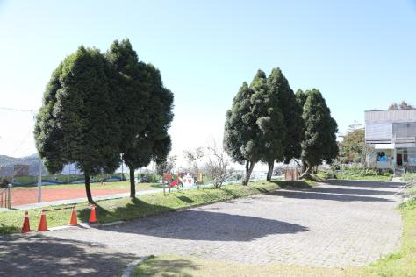
basketball court
ecological pond
baseball field
courtyard

Slide 10
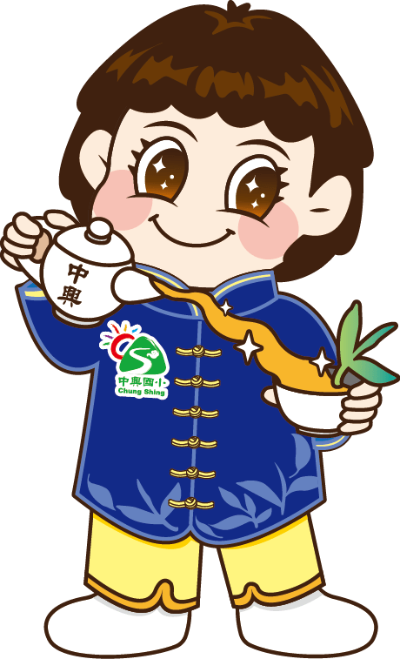
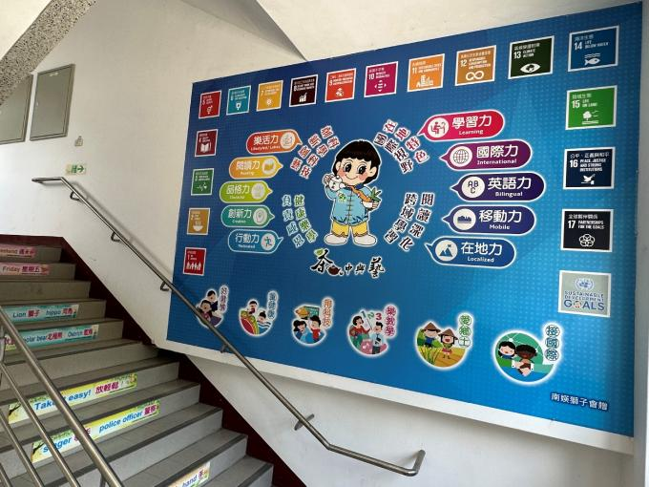
Bilingual SDGs Wall

Slide 11
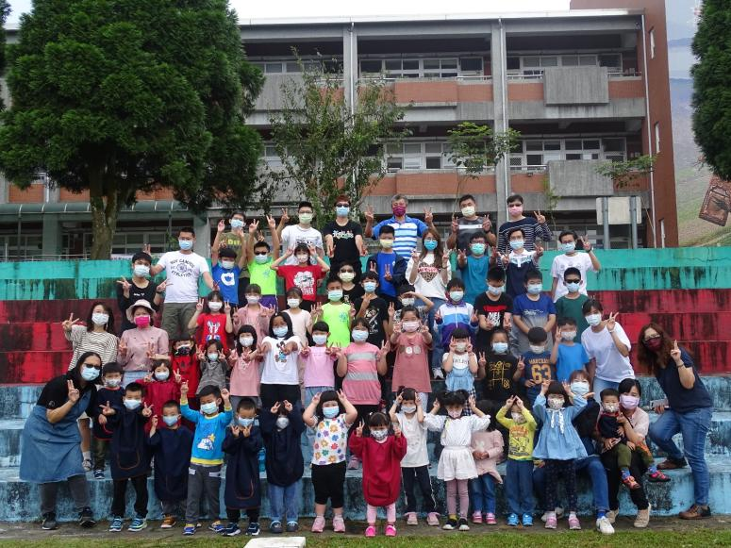
The school’s teachers and students

Slide 12
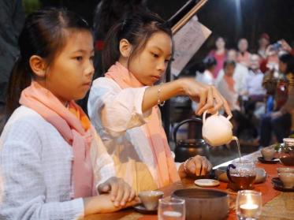
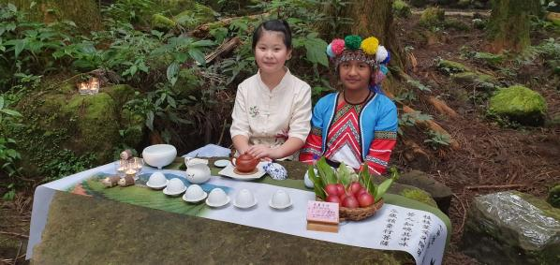
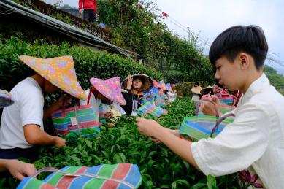
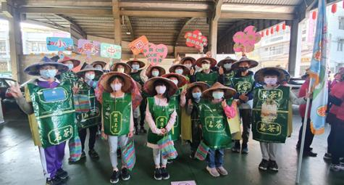
School Courses
tea art course

Slide 13
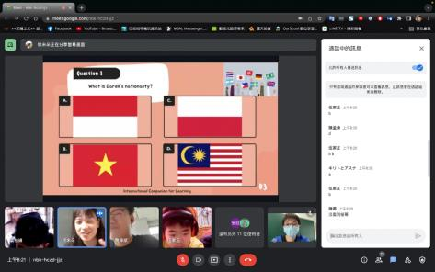
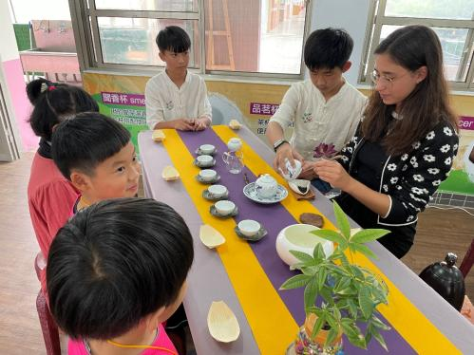
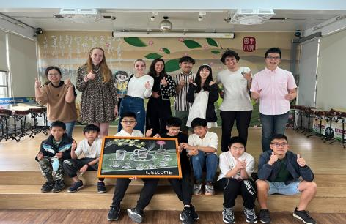
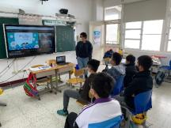
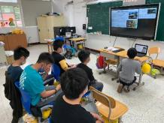
School Courses
ICL

Slide 14
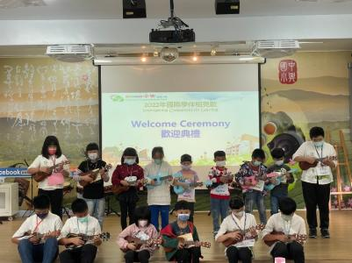
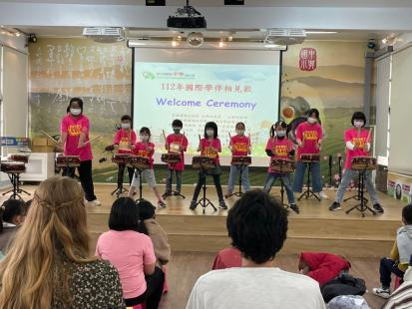
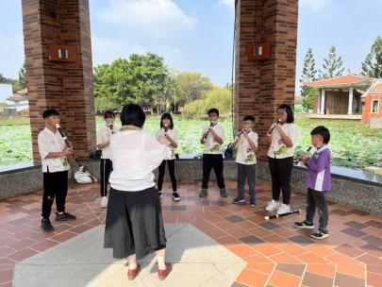
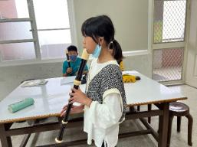
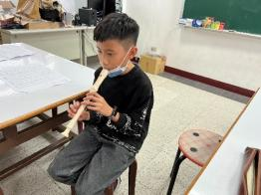
School Courses
flute and drum classes

Slide 15
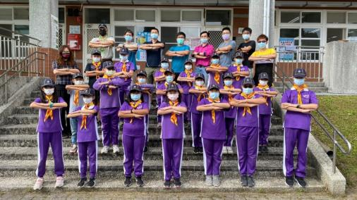
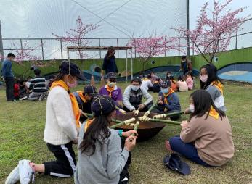
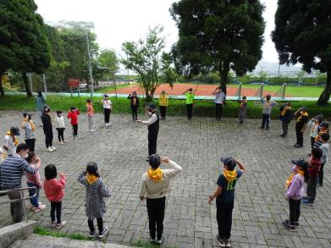
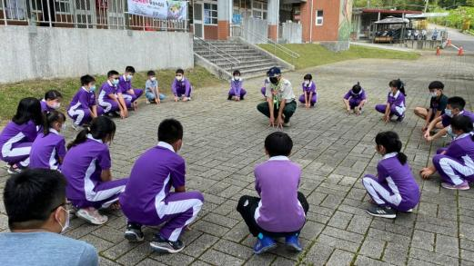
School Courses
Scout education

Slide 16
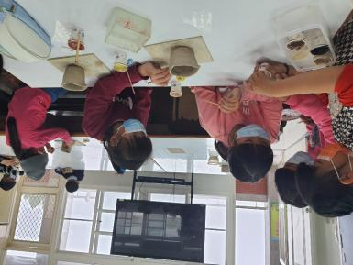
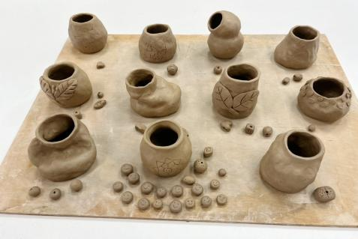
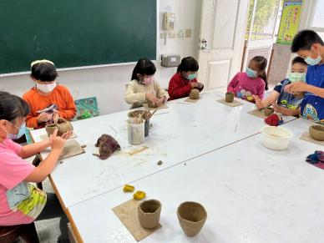
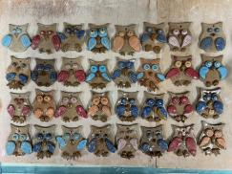
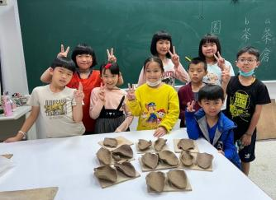
School Courses
pottery class

Slide 17
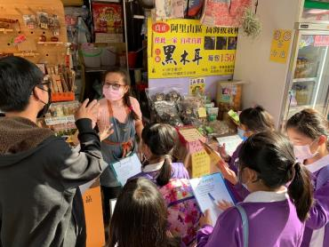
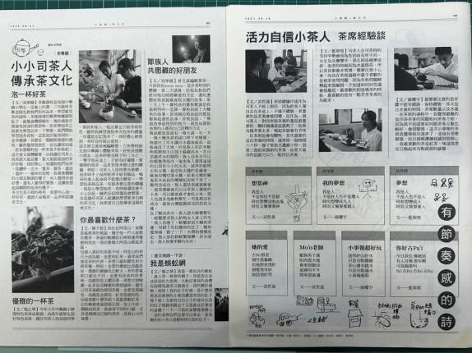
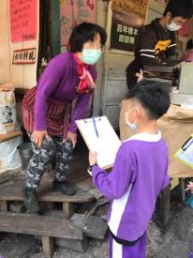
School Courses
newspaper writing class

Slide 18
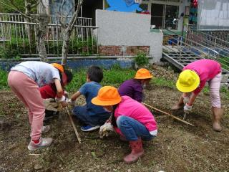
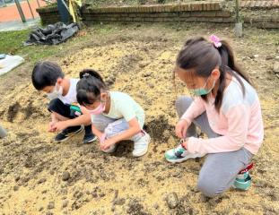
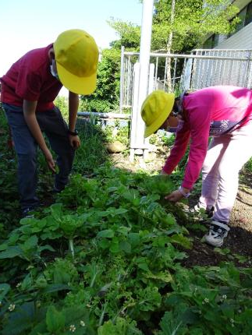
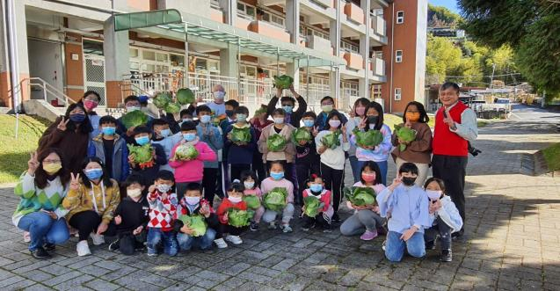
School Courses
food and farming education

Slide 19
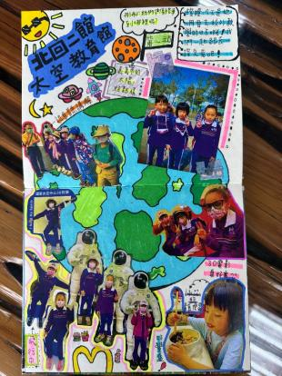
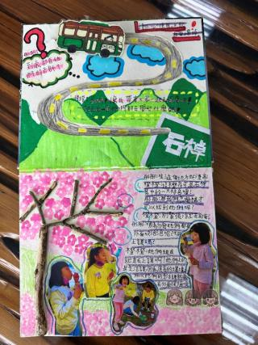
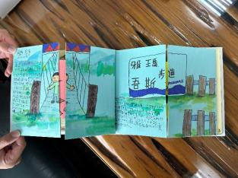
School Courses
handmade books

Slide 20
School Courses
international education

Slide 21
School Courses
international exchange

Slide 22
CSES team members

Slide 23
Our Team and Contact Window
Bruce Tseng
James Miller
Zoy Chen

Slide 24
Contact Window
Bruce (Chen-Fu) Tseng English Teacher
No.10-1, Shizhuo, Zhuqi Township, Chiayi County 604, Taiwan
bruce780117@gmail.com
P｜ +886-5-2561021
F｜ +886-5-2562230
School Website：https://www.cses.cyc.edu.tw/
Facebook：www.facebook.com/ChiayiCountyChungShing/

Slide 25
We’re looking forward to a collaboration
and partnership with you.

